Slide 1

Background | Motivation | Enhancement framework | Experimental results | Conclusions | Future directions
IEEE International Symposium on Multimedia 2012
A Variational Bayesian Inference Framework for
Multiview Depth Image Enhancement
Pravin Kumar Rana, Jalil Taghia, and Markus Flierl
School of Electrical Engineering
KTH Royal Institute of Technology
Stockholm, Sweden
December 10, 2012

Slide 2
Background | Motivation | Enhancement framework | Experimental results | Conclusions | Future directions
Background and motivation
ISM 2012 - Pravin Kumar Rana, A Variational Bayesian Inference Framework for Multiview Depth Image Enhancement

Slide 3
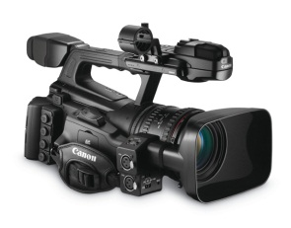
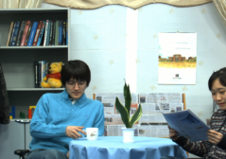
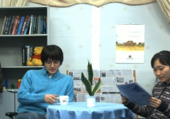


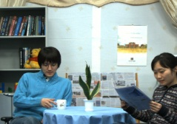
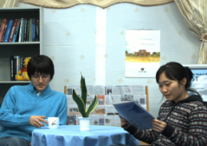
Background | Motivation | Enhancement framework | Experimental results | Conclusions | Future directions
Free-viewpoint television
User | Display
Multiview video imagery
ISM 2012 - Pravin Kumar Rana, A Variational Bayesian Inference Framework for Multiview Depth Image Enhancement 1

Slide 4
Background | Motivation | Enhancement framework | Experimental results | Conclusions | Future directions
Free-viewpoint television
User | Display
Multiview video imagery
ISM 2012 - Pravin Kumar Rana, A Variational Bayesian Inference Framework for Multiview Depth Image Enhancement 1

Slide 5
Background | Motivation | Enhancement framework | Experimental results | Conclusions | Future directions
Free-viewpoint television
User | Display
Multiview video imagery
ISM 2012 - Pravin Kumar Rana, A Variational Bayesian Inference Framework for Multiview Depth Image Enhancement 1

Slide 6
Background | Motivation | Enhancement framework | Experimental results | Conclusions | Future directions
Free-viewpoint television
User | Display
Multiview video imagery
ISM 2012 - Pravin Kumar Rana, A Variational Bayesian Inference Framework for Multiview Depth Image Enhancement 1

Slide 7
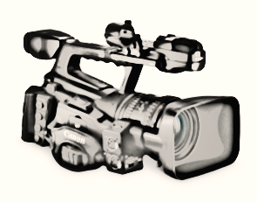
Background | Motivation | Enhancement framework | Experimental results | Conclusions | Future directions
Free-viewpoint television
User | Display
Virtual camera | Virtual view
Multiview video imagery
ISM 2012 - Pravin Kumar Rana, A Variational Bayesian Inference Framework for Multiview Depth Image Enhancement 1

Slide 8
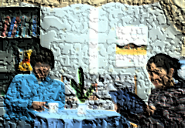
Background | Motivation | Enhancement framework | Experimental results | Conclusions | Future directions
Depth image based rendering
Virtual camera | Virtual view
Multiview video imagery
ISM 2012 - Pravin Kumar Rana, A Variational Bayesian Inference Framework for Multiview Depth Image Enhancement 2

Slide 9
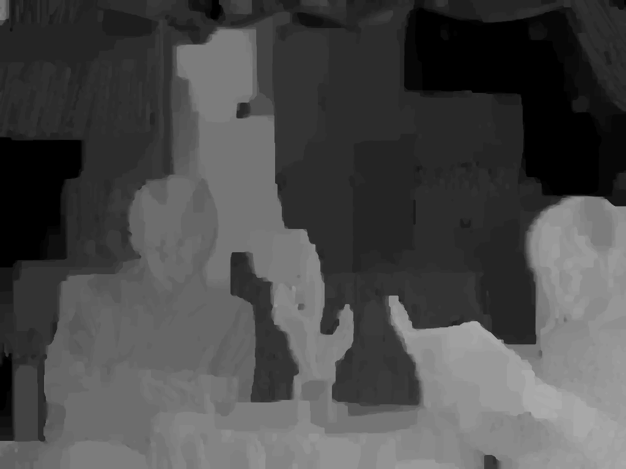
Background | Motivation | Enhancement framework | Experimental results | Conclusions | Future directions
Depth image based rendering
Depth pixels represent shortest distance between object points and the camera plane
To be estimated from multiview imagery
Depth image
Near
Far
Virtual camera | Virtual view
Multiview video imagery
ISM 2012 - Pravin Kumar Rana, A Variational Bayesian Inference Framework for Multiview Depth Image Enhancement 2

Slide 10
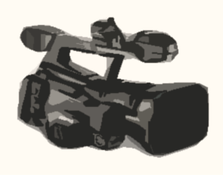
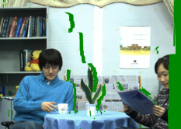

Background | Motivation | Enhancement framework | Experimental results | Conclusions | Future directions
Depth image based rendering
Depth pixels represent shortest distance between object points and the camera plane
To be estimated from multiview imagery
Depth image
Near
3D warping
Far
?
Virtual camera | Virtual view
Multiview video imagery
ISM 2012 - Pravin Kumar Rana, A Variational Bayesian Inference Framework for Multiview Depth Image Enhancement 2

Slide 11

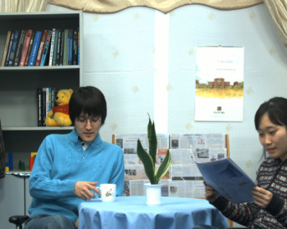

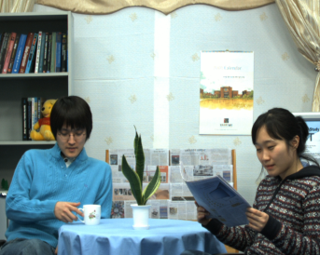
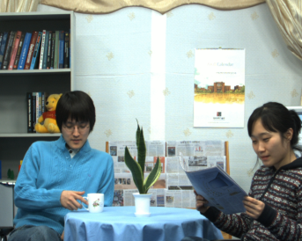

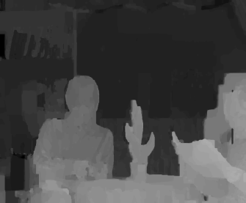
Background | Motivation | Enhancement framework | Experimental results | Conclusions | Future directions
Depth estimation
MPEG Depth Estimation Reference Software
View (n-2) | View (n-1) | View (n) | View (n+1) | View (n+2) | View (n+3)
Depth estimation
Common practice
 | View (n-1) | View 3 | View 4
Estimated depth map
ISM 2012 - Pravin Kumar Rana, A Variational Bayesian Inference Framework for Multiview Depth Image Enhancement 3

Slide 12
Background | Motivation | Enhancement framework | Experimental results | Conclusions | Future directions
Depth estimation
MPEG Depth Estimation Reference Software
View (n-2) | View (n-1) | View (n) | View (n+1) | View (n+2) | View (n+3)
Depth estimation
Depth estimation
Common practice
 | View (n-1) | View 3 | View 4 | View (n+2)
Estimated depth map
Estimated depth map
ISM 2012 - Pravin Kumar Rana, A Variational Bayesian Inference Framework for Multiview Depth Image Enhancement 3

Slide 13
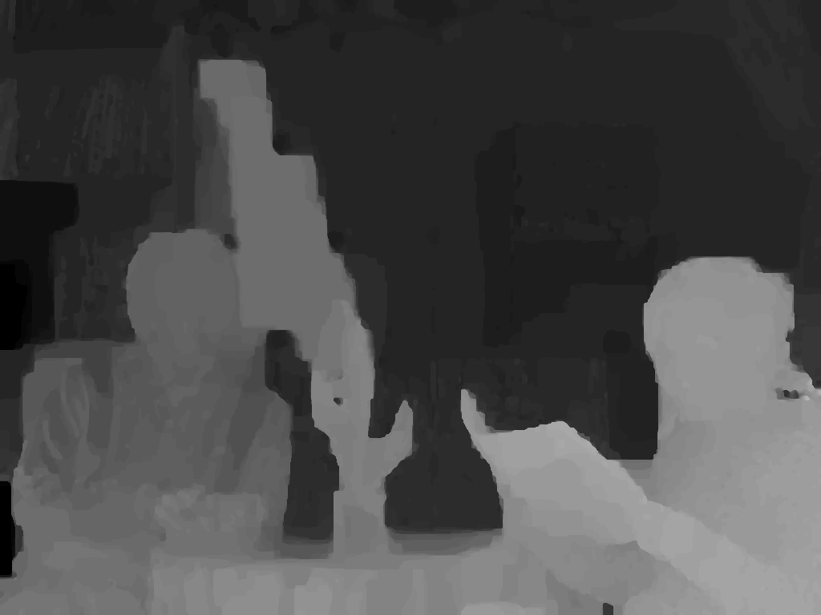
Background | Motivation | Enhancement framework | Experimental results | Conclusions | Future directions
Problem: Inter-view depth inconsistency
View (n-1)
ISM 2012 - Pravin Kumar Rana, A Variational Bayesian Inference Framework for Multiview Depth Image Enhancement 4

Slide 14
Background | Motivation | Enhancement framework | Experimental results | Conclusions | Future directions
Problem: Inter-view depth inconsistency
View (n-1) | View (n)
ISM 2012 - Pravin Kumar Rana, A Variational Bayesian Inference Framework for Multiview Depth Image Enhancement 4

Slide 15
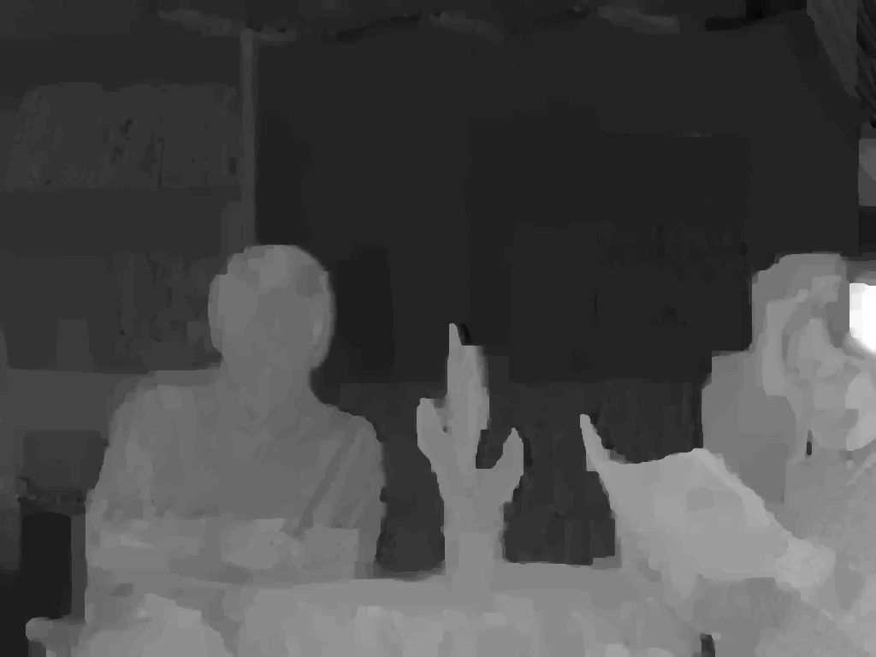
Background | Motivation | Enhancement framework | Experimental results | Conclusions | Future directions
Problem: Inter-view depth inconsistency
View (n-1) | View (n) | View (n+1)
ISM 2012 - Pravin Kumar Rana, A Variational Bayesian Inference Framework for Multiview Depth Image Enhancement 4

Slide 16
Background | Motivation | Enhancement framework | Experimental results | Conclusions | Future directions
Problem: Inter-view depth inconsistency
View (n-1) | View (n) | View (n+1)
ISM 2012 - Pravin Kumar Rana, A Variational Bayesian Inference Framework for Multiview Depth Image Enhancement 4

Slide 17
Background | Motivation | Enhancement framework | Experimental results | Conclusions | Future directions
Problem: Inter-view depth inconsistency
View (n-1) | View (n) | View (n+1)
ISM 2012 - Pravin Kumar Rana, A Variational Bayesian Inference Framework for Multiview Depth Image Enhancement 4

Slide 18
Background | Motivation | Enhancement framework | Experimental results | Conclusions | Future directions
Problem: Inter-view depth inconsistency
View (n-1) | View (n) | View (n+1)
ISM 2012 - Pravin Kumar Rana, A Variational Bayesian Inference Framework for Multiview Depth Image Enhancement 4

Slide 19
Background | Motivation | Enhancement framework | Experimental results | Conclusions | Future directions
Problem: Inter-view depth inconsistency
View (n-1) | View (n) | View (n+1)
Note: we assume a 1D-parallel camera arrangement
ISM 2012 - Pravin Kumar Rana, A Variational Bayesian Inference Framework for Multiview Depth Image Enhancement 4

Slide 20
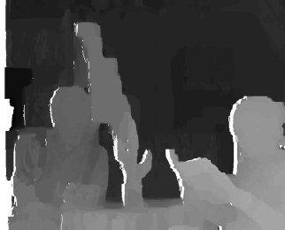
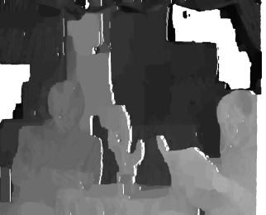
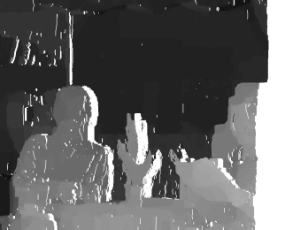
Background | Motivation | Enhancement framework | Experimental results | Conclusions | Future directions
Prior work on depth enhancement
Existing methods warp depth images from multiple viewpoints to a common viewpoint for spatial alignment ([2], [3])
Warping errors due to the discrete values in depth maps affects enhancement algorithms negatively
 | View (1) |  | View (2) |  |  |  | View (n)
3D warping
View (m)
Spatial alignment
[2] P. K. Rana and M. Flierl, “Depth consistency testing for improved view interpolation,” IEEE Int. Workshop MMSP, 2010.
[3] E. Ekmekcioglu, V. Velisavljevic, and S. Worrall, “Content adaptive enhancement of multi-view depth maps for free viewpoint video,” IEEE J. Sel. Topics Signal Process., 2011.
ISM 2012 - Pravin Kumar Rana, A Variational Bayesian Inference Framework for Multiview Depth Image Enhancement 5

Slide 21
Background | Motivation | Enhancement framework | Experimental results | Conclusions | Future directions
New depth enhancement framework
ISM 2012 - Pravin Kumar Rana, A Variational Bayesian Inference Framework for Multiview Depth Image Enhancement

Slide 22
Background | Motivation | Enhancement framework | Experimental results | Conclusions | Future directions
Overview of new depth enhancement framework
Concatenation of view imagery
Multiview color classification
Multiview depth classification
Depth image enhancement
ISM 2012 - Pravin Kumar Rana, A Variational Bayesian Inference Framework for Multiview Depth Image Enhancement 6

Slide 23
Background | Motivation | Enhancement framework | Experimental results | Conclusions | Future directions
Concatenation of view imagery
The captured MVV imagery of the scene has inherent inter-view similarity
To have a unique model for the captured natural scene,
The MVV inter-view similarity is exploited by concatenating views from multiple viewpoints
View (n-1) | View (n) | View (n+1) | View (n+2)
ISM 2012 - Pravin Kumar Rana, A Variational Bayesian Inference Framework for Multiview Depth Image Enhancement 7

Slide 24
Background | Motivation | Enhancement framework | Experimental results | Conclusions | Future directions
Concatenation of view imagery
The captured MVV imagery of the scene has inherent inter-view similarity
To have a unique model for the captured natural scene,
The MVV inter-view similarity is exploited by concatenating views from multiple viewpoints
View (n-1) | View (n) | View (n+1) | View (n+2)
View (n-1) | View (n) | View (n+1) | View (n+2)
ISM 2012 - Pravin Kumar Rana, A Variational Bayesian Inference Framework for Multiview Depth Image Enhancement 7

Slide 25
Background | Motivation | Enhancement framework | Experimental results | Conclusions | Future directions
Multiview color classification
Gaussian mixture model with variational Bayes inference
The goal of classification is to partition an image into regions each of which has a reasonably homogeneous visual appearance
Usually, classification algorithm, such as expectation-maximization for Gaussian mixtures, suffers from two main drawbacks:
model over-ﬁtting and
the number of clusters has to be known, (similar to the K-means algorithm)
The Gaussian mixture model is used with variational Bayes inference [4] because
no model over-fitting and
the number of clusters is treated as a random variable
[4] C. M. Bishop, Pattern Recognition and Machine Learning, 1st ed. New York: Springer, 2006.
ISM 2012 - Pravin Kumar Rana, A Variational Bayesian Inference Framework for Multiview Depth Image Enhancement 8

Slide 26

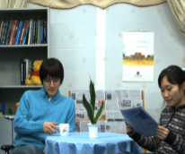
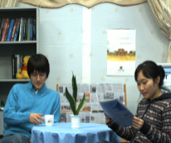
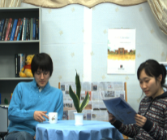
Background | Motivation | Enhancement framework | Experimental results | Conclusions | Future directions
Multiview color classification
Gaussian mixture model with variational Bayes inference
Initial number
of clusters
Final number
of clusters
RGB
View (n-1) | View (n) | View (n+1) | View (n+2)
N views
3 X (NXHXW)
50
35
[4] C. M. Bishop, Pattern Recognition and Machine Learning, 1st ed. New York: Springer, 2006.
ISM 2012 - Pravin Kumar Rana, A Variational Bayesian Inference Framework for Multiview Depth Image Enhancement 9

Slide 27

Background | Motivation | Enhancement framework | Experimental results | Conclusions | Future directions
Multiview color classification
Example: Newspaper
Color classification input
Color clusters
ISM 2012 - Pravin Kumar Rana, A Variational Bayesian Inference Framework for Multiview Depth Image Enhancement 10

Slide 28

Background | Motivation | Enhancement framework | Experimental results | Conclusions | Future directions
Multiview color classification
Example: Newspaper
Color classification input
Color clusters
ISM 2012 - Pravin Kumar Rana, A Variational Bayesian Inference Framework for Multiview Depth Image Enhancement 10

Slide 29
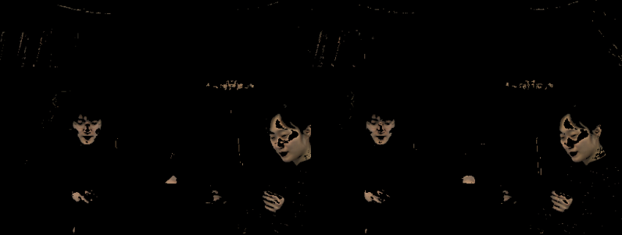
Background | Motivation | Enhancement framework | Experimental results | Conclusions | Future directions
Multiview color classification
Example: Newspaper
Color classification input
Color clusters
ISM 2012 - Pravin Kumar Rana, A Variational Bayesian Inference Framework for Multiview Depth Image Enhancement 10

Slide 30
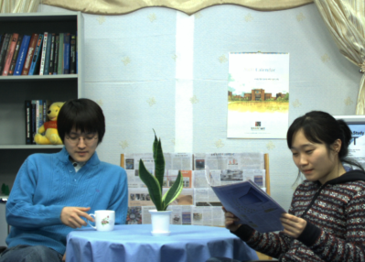

Background | Motivation | Enhancement framework | Experimental results | Conclusions | Future directions
Multiview depth classification
Exploiting the per-pixel association between color and depth
View image | Depth image
Concatenated view imagery | Concatenated depth imagery
ISM 2012 - Pravin Kumar Rana, A Variational Bayesian Inference Framework for Multiview Depth Image Enhancement 11

Slide 31
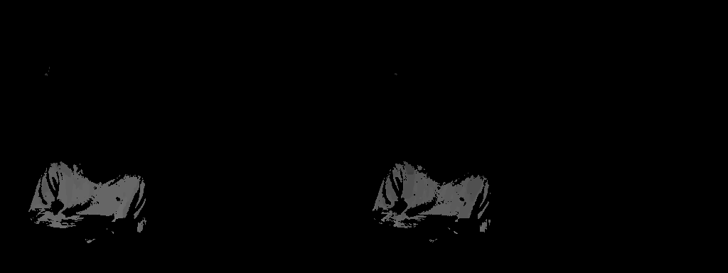

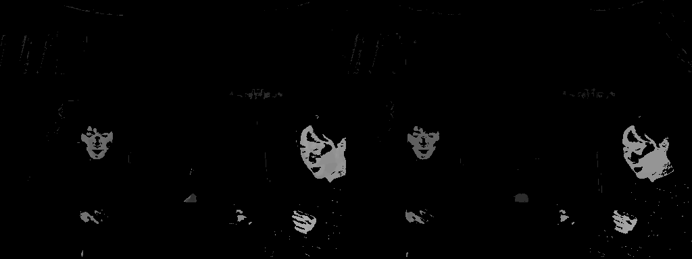
Background | Motivation | Enhancement framework | Experimental results | Conclusions | Future directions
Multiview depth classification
Example: Newspaper
Color clusters
Depth clusters
ISM 2012 - Pravin Kumar Rana, A Variational Bayesian Inference Framework for Multiview Depth Image Enhancement 12

Slide 32
Background | Motivation | Enhancement framework | Experimental results | Conclusions | Future directions
Multiview depth enhancement
Difference between color and depth clusters
Members have similar colors pixels
Members may have different depth values
ISM 2012 - Pravin Kumar Rana, A Variational Bayesian Inference Framework for Multiview Depth Image Enhancement 13
Notes:
The members of a cluster are similar colors, whereas members of the corresponding depth cluster are different depth values.
Inter-view depth inconsistency : If an object point with a given color is visible from N viewpoints, this point should have the same depth value in all N depth maps.
However, such points usually have different depth values in the depth cluster due to the inconsistency across multiple viewpoints.

Slide 33
Background | Motivation | Enhancement framework | Experimental results | Conclusions | Future directions
Multiview depth enhancement
Difference between color and depth clusters
Members have similar colors pixels
Members may have different depth values
Why?
Due to foreground and background depth difference
Due to inter-view inconsistency
ISM 2012 - Pravin Kumar Rana, A Variational Bayesian Inference Framework for Multiview Depth Image Enhancement 13
Notes:
The members of a cluster are similar colors, whereas members of the corresponding depth cluster are different depth values.
Inter-view depth inconsistency : If an object point with a given color is visible from N viewpoints, this point should have the same depth value in all N depth maps.
However, such points usually have different depth values in the depth cluster due to the inconsistency across multiple viewpoints.

Slide 34
Background | Motivation | Enhancement framework | Experimental results | Conclusions | Future directions
Multiview depth enhancement
Difference between color and depth clusters
Members have similar colors pixels
Members may have different depth values
Why?
Due to foreground and background depth difference
Due to inter-view inconsistency
Our approach: K-means sub-clustering
Computationally fast
Assigns the mean to depth pixels irrespective of the originating viewpoints
Usually, Bayesian approaches imply higher computational complexity
ISM 2012 - Pravin Kumar Rana, A Variational Bayesian Inference Framework for Multiview Depth Image Enhancement 14
Notes:
The members of a cluster are similar colors, whereas members of the corresponding depth cluster are different depth values.
Inter-view depth inconsistency : If an object point with a given color is visible from N viewpoints, this point should have the same depth value in all N depth maps.
However, such points usually have different depth values in the depth cluster due to the inconsistency across multiple viewpoints.

Slide 35
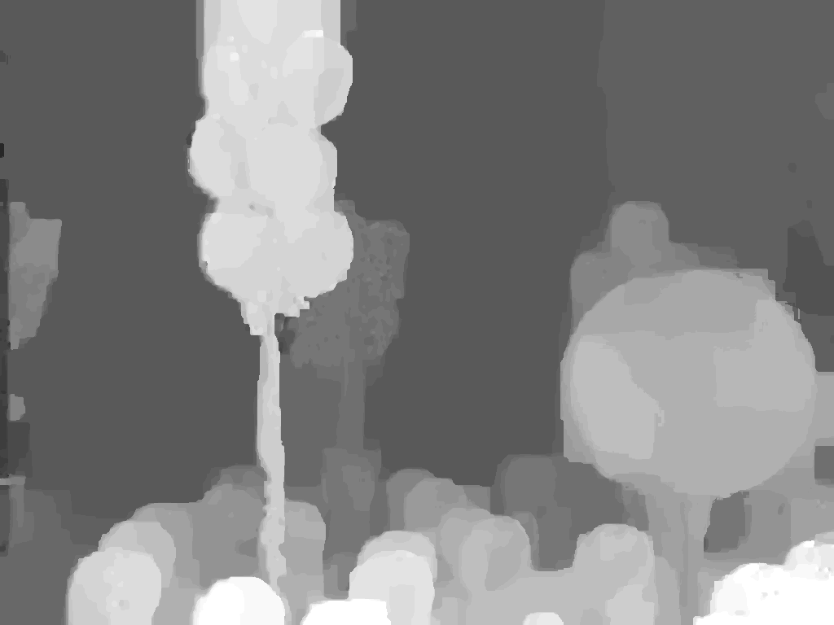
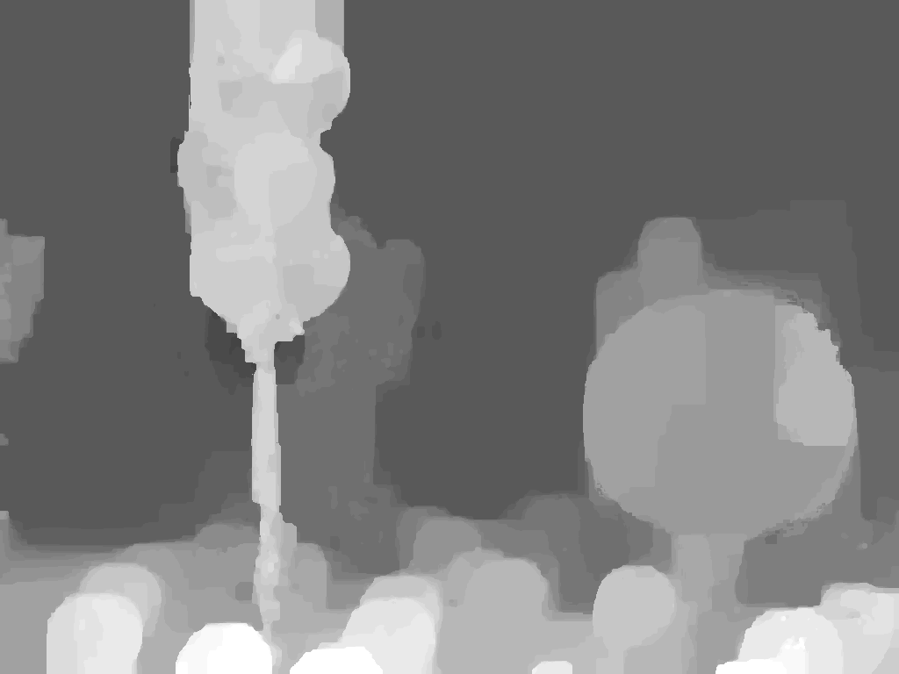
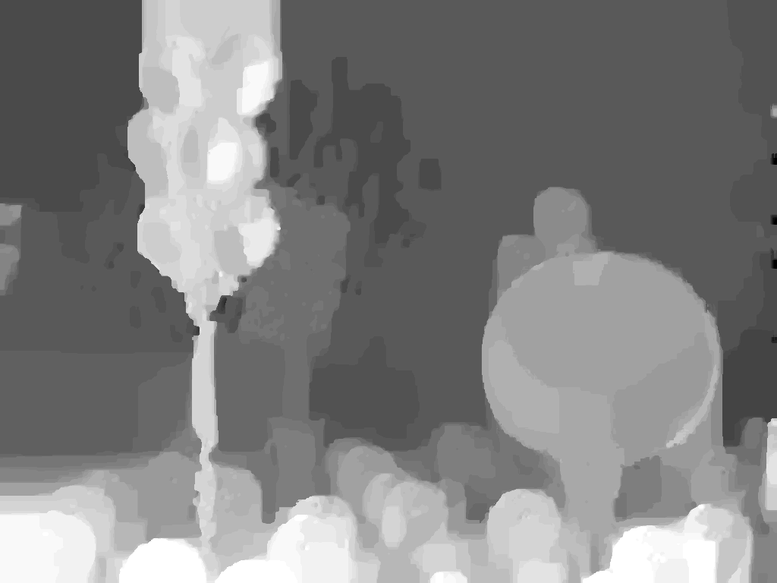
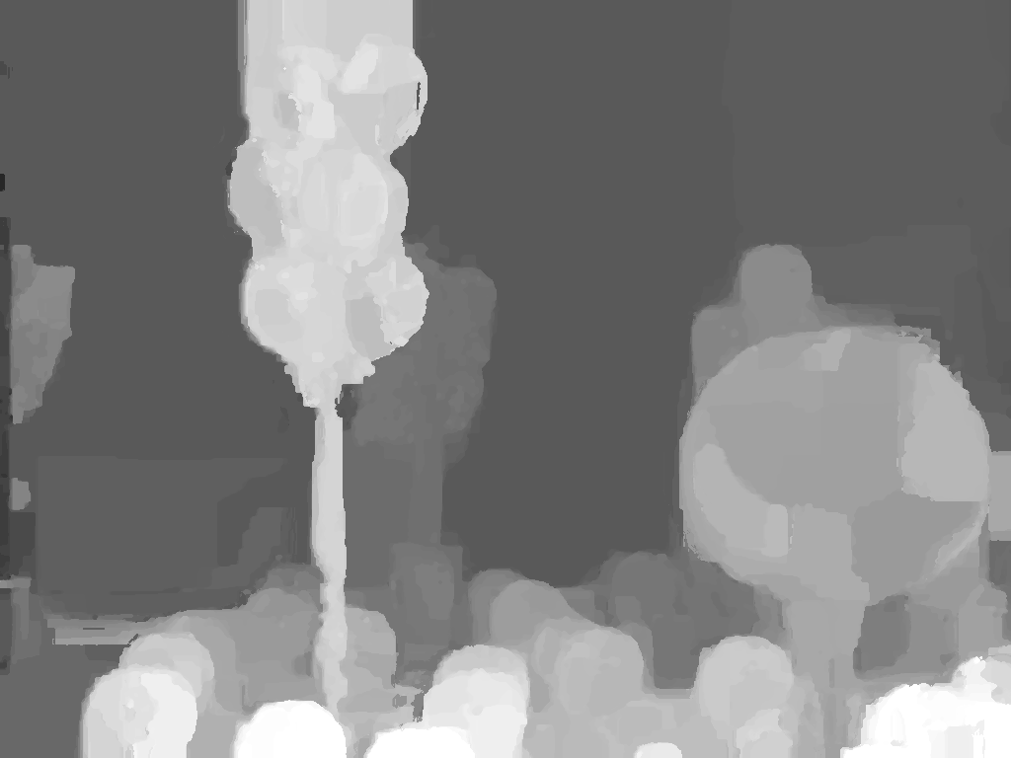
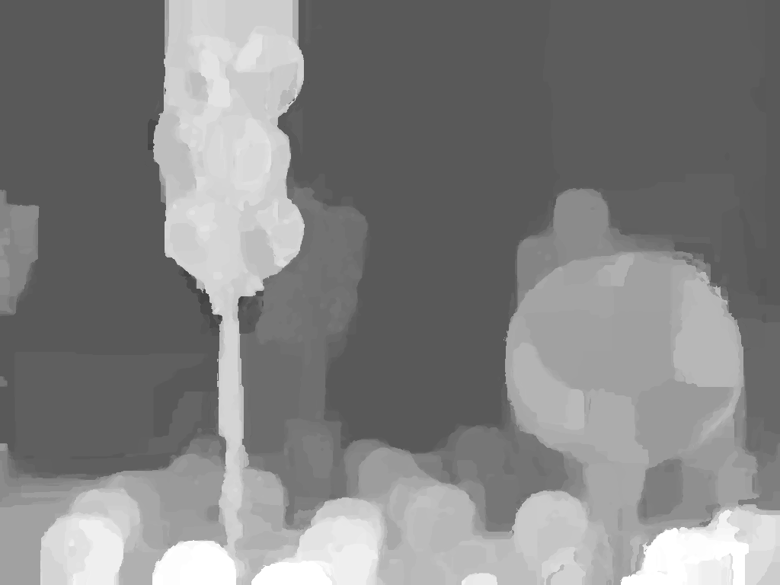
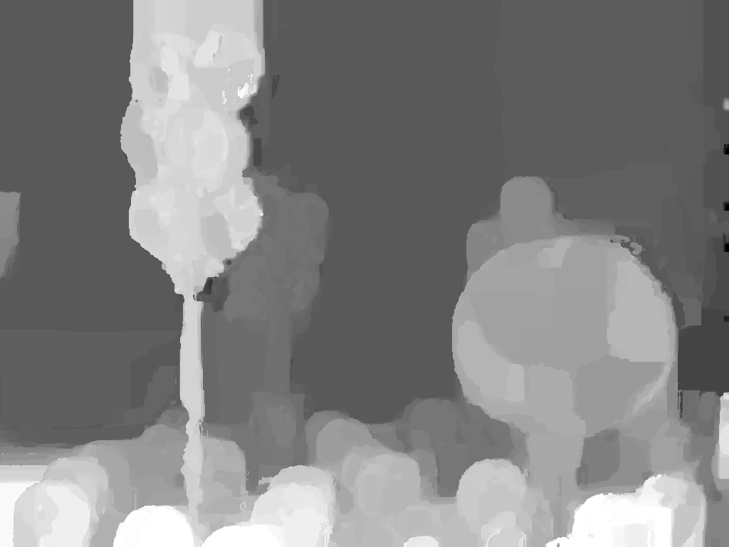
Background | Motivation | Enhancement framework | Experimental results | Conclusions | Future directions
Multiview depth enhancement
Example: Balloons
MPEG depth maps
Enhanced depth maps
ISM 2012 - Pravin Kumar Rana, A Variational Bayesian Inference Framework for Multiview Depth Image Enhancement 15

Slide 36
Background | Motivation | Enhancement framework | Experimental results | Conclusions | Future directions
Multiview depth enhancement
Example: Balloons
MPEG depth maps
Enhanced depth maps
ISM 2012 - Pravin Kumar Rana, A Variational Bayesian Inference Framework for Multiview Depth Image Enhancement 15

Slide 37
Background | Motivation | Enhancement framework | Experimental results | Conclusions | Future directions
Multiview depth enhancement
Example: Balloons
MPEG depth maps
Enhanced depth maps
ISM 2012 - Pravin Kumar Rana, A Variational Bayesian Inference Framework for Multiview Depth Image Enhancement 15

Slide 38

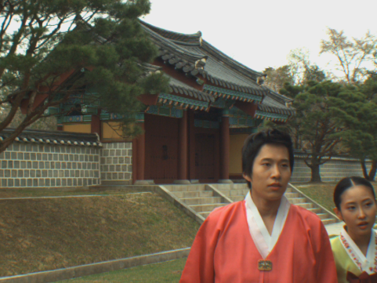
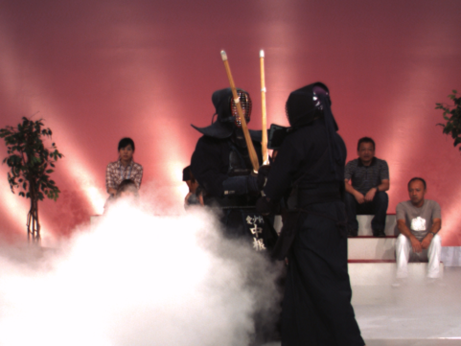
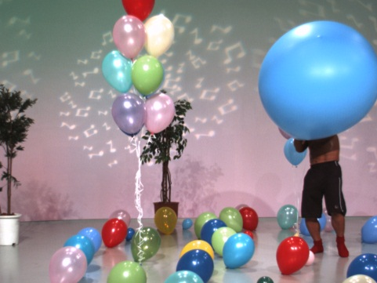
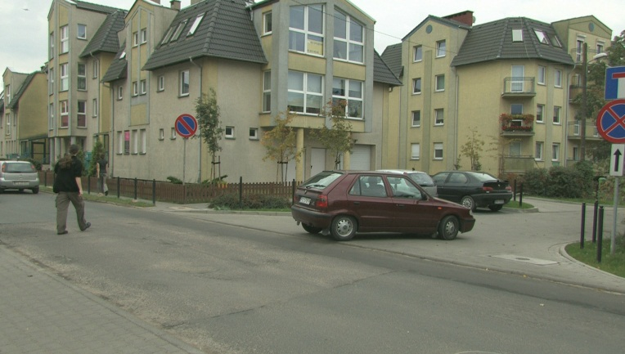
Background | Motivation | Enhancement framework | Experimental results | Conclusions | Future directions
Experimental setup
MPEG 3DTV multiview data set
Newspaper
(1024 X 768)
Lovebird1
(1024 X 768)
Kendo
(1024 X 768)
Balloons
(1024 X 768)
Poznan street
(1920 X 1088)
ISM 2012 - Pravin Kumar Rana, A Variational Bayesian Inference Framework for Multiview Depth Image Enhancement 16

Slide 39
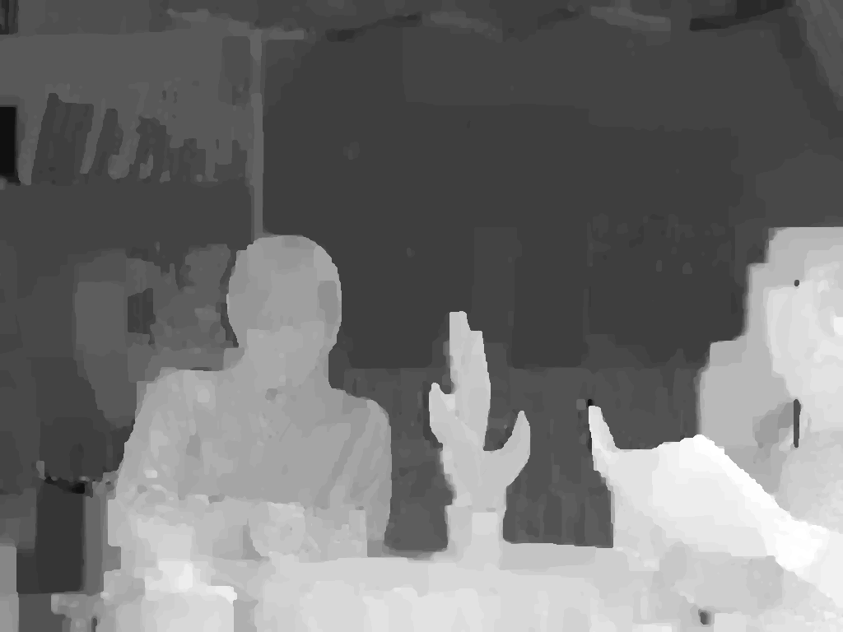
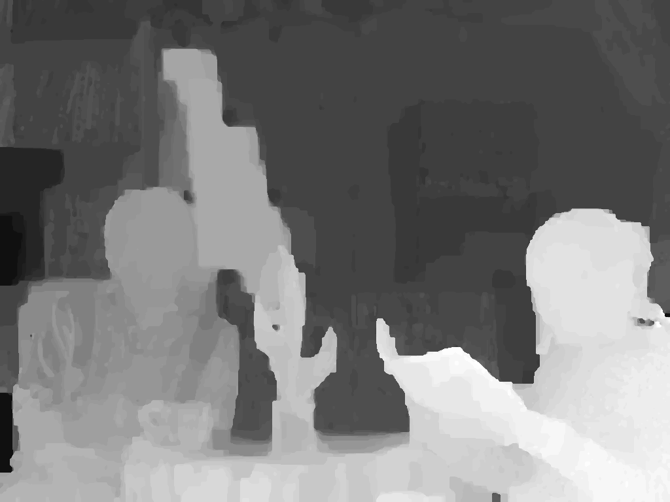
Background | Motivation | Enhancement framework | Experimental results | Conclusions | Future directions
Depth image based rendering
MPEG View Synthesis Reference Software (VSRS) 3.5
Enhanced depth map
Left
Enhanced depth map
Right
ISM 2012 - Pravin Kumar Rana, A Variational Bayesian Inference Framework for Multiview Depth Image Enhancement 17

Slide 40
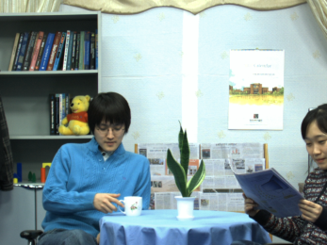

Background | Motivation | Enhancement framework | Experimental results | Conclusions | Future directions
Depth image based rendering
MPEG View Synthesis Reference Software (VSRS) 3.5
Enhanced depth map
3D warping
Left
Reference view
Enhanced depth map
3D warping
Right
Reference view
ISM 2012 - Pravin Kumar Rana, A Variational Bayesian Inference Framework for Multiview Depth Image Enhancement 17

Slide 41

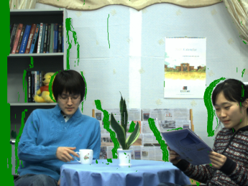
Background | Motivation | Enhancement framework | Experimental results | Conclusions | Future directions
Depth image based rendering
MPEG View Synthesis Reference Software (VSRS) 3.5
Enhanced depth map
Warped view
3D warping
Left
Reference view
Enhanced depth map
3D warping
Right
Warped view
Reference view
ISM 2012 - Pravin Kumar Rana, A Variational Bayesian Inference Framework for Multiview Depth Image Enhancement 17

Slide 42
Background | Motivation | Enhancement framework | Experimental results | Conclusions | Future directions
Depth image based rendering
MPEG View Synthesis Reference Software (VSRS) 3.5
Enhanced depth map
Warped view
3D warping
Left
Reference view
Hole filling & inpainting
Enhanced depth map
3D warping
Right
Warped view
Reference view
ISM 2012 - Pravin Kumar Rana, A Variational Bayesian Inference Framework for Multiview Depth Image Enhancement 17

Slide 43
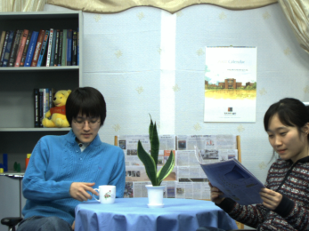
Background | Motivation | Enhancement framework | Experimental results | Conclusions | Future directions
Depth image based rendering
MPEG View Synthesis Reference Software (VSRS) 3.5
Enhanced depth map
Warped view
3D warping
Left
Reference view
Hole filling & inpainting
Enhanced depth map
Virtual intermediate view
3D warping
Right
Warped view
Reference view
ISM 2012 - Pravin Kumar Rana, A Variational Bayesian Inference Framework for Multiview Depth Image Enhancement 17

Slide 44

Background | Motivation | Enhancement framework | Experimental results | Conclusions | Future directions
Depth image based rendering
MPEG View Synthesis Reference Software (VSRS) 3.5
Enhanced depth map
Warped view
3D warping
Left
Reference view
Hole filling & inpainting
Enhanced depth map
Virtual intermediate view
3D warping
Right
Warped view
Reference view
Original camera view
ISM 2012 - Pravin Kumar Rana, A Variational Bayesian Inference Framework for Multiview Depth Image Enhancement 17

Slide 45
Background | Motivation | Enhancement framework | Experimental results | Conclusions | Future directions
Depth image based rendering
MPEG View Synthesis Reference Software (VSRS) 3.5
Enhanced depth map
Warped view
3D warping
Left
Y-PSNR (dB)
Reference view
Hole filling & inpainting
Enhanced depth map
Virtual intermediate view
3D warping
Right
Warped view
Reference view
Original camera view
ISM 2012 - Pravin Kumar Rana, A Variational Bayesian Inference Framework for Multiview Depth Image Enhancement 17

Slide 46
Background | Motivation | Enhancement framework | Experimental results | Conclusions | Future directions
Objective results
Test sequence | Sequence resolution | Input views | Virtual view | MPEG VSRS views Y-PSNR 3.5 [dB]
 |  |  |  | MPEG depth maps | Enhanced depth maps
Newspaper | 1024 X 768 | 4,6 | 5 | 31.98 | 32.10
Kendo | 1024 X 768 | 3,5 | 5 | 36.54 | 36.72
Poznan Street | 1920 X 1088 | 3,5 | 4 | 35.56 | 35.58
Lovebird1 | 1024 X 768 | 6,8 | 7 | 28.50 | 28.68
Balloons | 1024 X 768 | 3,5 | 4 | 35.68 | 35.93
Color classification
Initial number of color clusters: 50
K-means sub-clustering
Number of cluster : 12
ISM 2012 - Pravin Kumar Rana, A Variational Bayesian Inference Framework for Multiview Depth Image Enhancement 18

Slide 47
Background | Motivation | Enhancement framework | Experimental results | Conclusions | Future directions
Objective results
Test sequence | Sequence resolution | Input views | Virtual view | MPEG VSRS views Y-PSNR 3.5 [dB]
 |  |  |  | MPEG depth maps | Enhanced depth maps
Newspaper | 1024 X 768 | 4,6 | 5 | 31.98 | 32.10
Kendo | 1024 X 768 | 3,5 | 5 | 36.54 | 36.72
Poznan Street | 1920 X 1088 | 3,5 | 4 | 35.56 | 35.58
Lovebird1 | 1024 X 768 | 6,8 | 7 | 28.50 | 28.68
Balloons | 1024 X 768 | 3,5 | 4 | 35.68 | 35.93
Color classification
Initial number of color clusters: 50
K-means sub-clustering
Number of cluster : 12
ISM 2012 - Pravin Kumar Rana, A Variational Bayesian Inference Framework for Multiview Depth Image Enhancement 18

Slide 48
Background | Motivation | Enhancement framework | Experimental results | Conclusions | Future directions
Objective results
Test sequence | Sequence resolution | Input views | Virtual view | MPEG VSRS views Y-PSNR 3.5 [dB]
 |  |  |  | MPEG depth maps | Enhanced depth maps
Newspaper | 1024 X 768 | 4,6 | 5 | 31.98 | 32.10
Kendo | 1024 X 768 | 3,5 | 5 | 36.54 | 36.72
Poznan Street | 1920 X 1088 | 3,5 | 4 | 35.56 | 35.58
Lovebird1 | 1024 X 768 | 6,8 | 7 | 28.50 | 28.68
Balloons | 1024 X 768 | 3,5 | 4 | 35.68 | 35.93
Color classification
Initial number of color clusters: 50
K-means sub-clustering
Number of cluster : 12
ISM 2012 - Pravin Kumar Rana, A Variational Bayesian Inference Framework for Multiview Depth Image Enhancement 18

Slide 49
Background | Motivation | Enhancement framework | Experimental results | Conclusions | Future directions
Objective results
Test sequence | Sequence resolution | Input views | Virtual view | MPEG VSRS 3.5 [dB]
 |  |  |  | MPEG depth maps | Enhanced depth maps
Newspaper | 1024 X 768 | 4,6 | 5 | 31.98 | 32.10
Kendo | 1024 X 768 | 3,5 | 5 | 36.54 | 36.72
Poznan Street | 1920 X 1088 | 3,5 | 4 | 35.56 | 35.58
Lovebird1 | 1024 X 768 | 6,8 | 7 | 28.50 | 28.68
Balloons | 1024 X 768 | 3,5 | 4 | 35.68 | 35.93
Color classification
Initial number of color clusters: 50
K-means sub-clustering
Number of cluster : 12
ISM 2012 - Pravin Kumar Rana, A Variational Bayesian Inference Framework for Multiview Depth Image Enhancement 18

Slide 50
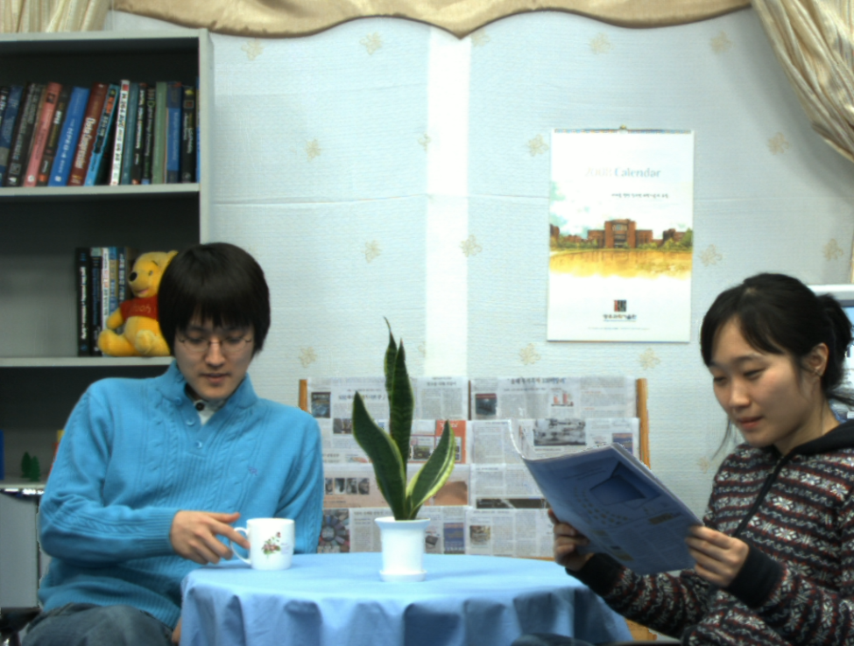

Background | Motivation | Enhancement framework | Experimental results | Conclusions | Future directions
Subjective comparison
Sequence: Newspaper
With MPEG depth
With enhanced depth
ISM 2012 - Pravin Kumar Rana, A Variational Bayesian Inference Framework for Multiview Depth Image Enhancement 19

Slide 51
Background | Motivation | Enhancement framework | Experimental results | Conclusions | Future directions
Subjective comparison
Sequence: Newspaper
With MPEG depth
With enhanced depth
ISM 2012 - Pravin Kumar Rana, A Variational Bayesian Inference Framework for Multiview Depth Image Enhancement 19

Slide 52
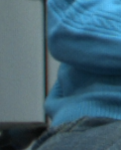
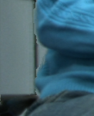
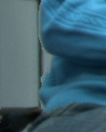
Background | Motivation | Enhancement framework | Experimental results | Conclusions | Future directions
Subjective comparison
Sequence: Newspaper
Original
With MPEG depth
With enhanced depth
ISM 2012 - Pravin Kumar Rana, A Variational Bayesian Inference Framework for Multiview Depth Image Enhancement 19

Slide 53
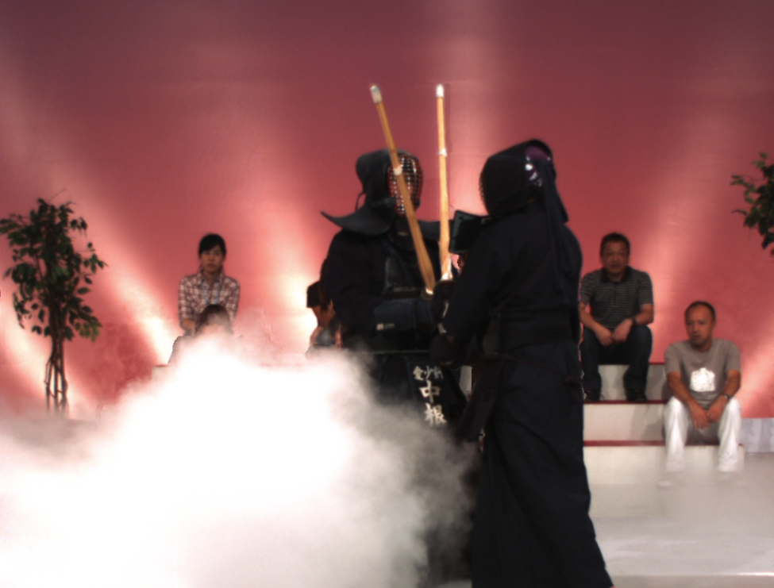
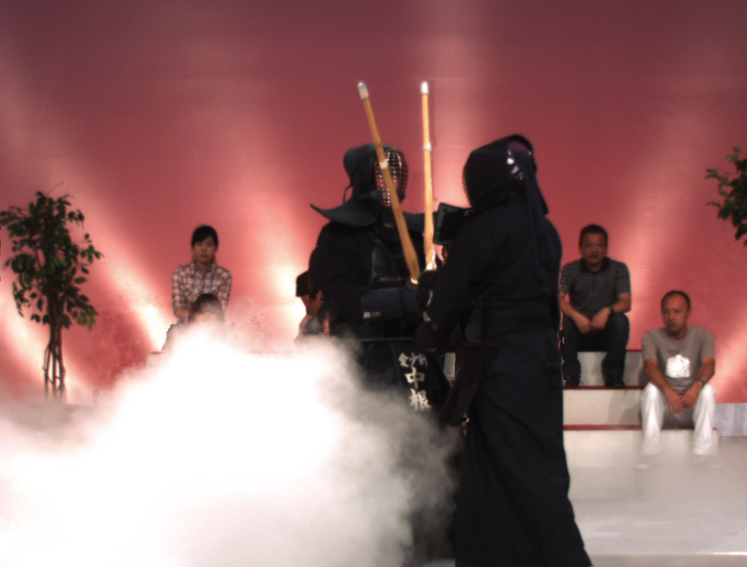
Background | Motivation | Enhancement framework | Experimental results | Conclusions | Future directions
Subjective comparison
Sequence: Kendo
With MPEG depth
With enhanced depth
ISM 2012 - Pravin Kumar Rana, A Variational Bayesian Inference Framework for Multiview Depth Image Enhancement 20

Slide 54
Background | Motivation | Enhancement framework | Experimental results | Conclusions | Future directions
Subjective comparison
Sequence: Kendo
With MPEG depth
With enhanced depth
ISM 2012 - Pravin Kumar Rana, A Variational Bayesian Inference Framework for Multiview Depth Image Enhancement 20

Slide 55
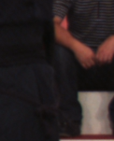
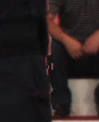

Background | Motivation | Enhancement framework | Experimental results | Conclusions | Future directions
Subjective comparison
Sequence: Kendo
Original
With MPEG depth
With enhanced depth
ISM 2012 - Pravin Kumar Rana, A Variational Bayesian Inference Framework for Multiview Depth Image Enhancement 20

Slide 56
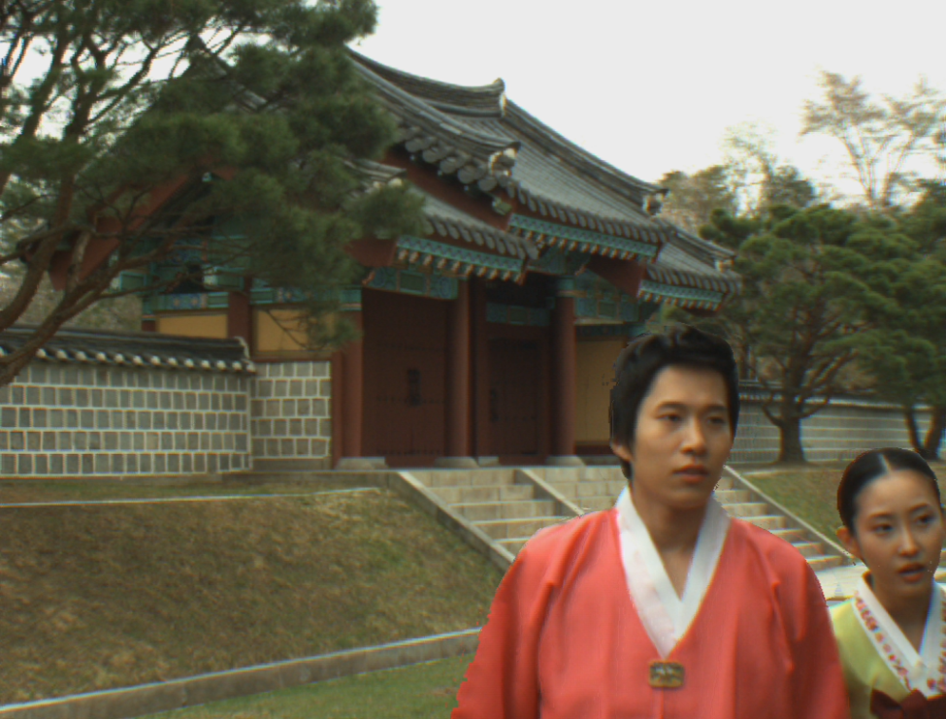

Background | Motivation | Enhancement framework | Experimental results | Conclusions | Future directions
Subjective comparison
Sequence: Lovebird 1
With MPEG depth
With enhanced depth
ISM 2012 - Pravin Kumar Rana, A Variational Bayesian Inference Framework for Multiview Depth Image Enhancement 21

Slide 57
Background | Motivation | Enhancement framework | Experimental results | Conclusions | Future directions
Subjective comparison
Sequence: Lovebird 1
With MPEG depth
With enhanced depth
ISM 2012 - Pravin Kumar Rana, A Variational Bayesian Inference Framework for Multiview Depth Image Enhancement 21

Slide 58



Background | Motivation | Enhancement framework | Experimental results | Conclusions | Future directions
Subjective comparison
Sequence: Lovebird 1
Original
With MPEG depth
With enhanced depth
ISM 2012 - Pravin Kumar Rana, A Variational Bayesian Inference Framework for Multiview Depth Image Enhancement 21

Slide 59
Background | Motivation | Enhancement framework | Experimental results | Conclusions | Future directions
Subjective comparison
Sequence: Lovebird 1
With MPEG depth
With enhanced depth
ISM 2012 - Pravin Kumar Rana, A Variational Bayesian Inference Framework for Multiview Depth Image Enhancement 21

Slide 60



Background | Motivation | Enhancement framework | Experimental results | Conclusions | Future directions
Subjective comparison
Sequence: Lovebird 1
Original
With MPEG depth
With enhanced depth
ISM 2012 - Pravin Kumar Rana, A Variational Bayesian Inference Framework for Multiview Depth Image Enhancement 21

Slide 61


Background | Motivation | Enhancement framework | Experimental results | Conclusions | Future directions
Subjective comparison
Sequence: Balloons
With MPEG depth
With enhanced depth
ISM 2012 - Pravin Kumar Rana, A Variational Bayesian Inference Framework for Multiview Depth Image Enhancement 22

Slide 62
Background | Motivation | Enhancement framework | Experimental results | Conclusions | Future directions
Subjective comparison
Sequence: Balloons
With MPEG depth
With enhanced depth
ISM 2012 - Pravin Kumar Rana, A Variational Bayesian Inference Framework for Multiview Depth Image Enhancement 22

Slide 63



Background | Motivation | Enhancement framework | Experimental results | Conclusions | Future directions
Subjective comparison
Sequence: Balloons
Original
With MPEG depth
With enhanced depth
ISM 2012 - Pravin Kumar Rana, A Variational Bayesian Inference Framework for Multiview Depth Image Enhancement 22

Slide 64


Background | Motivation | Enhancement framework | Experimental results | Conclusions | Future directions
Subjective comparison
Sequence: Poznan Street
With MPEG depth
With enhanced depth
ISM 2012 - Pravin Kumar Rana, A Variational Bayesian Inference Framework for Multiview Depth Image Enhancement 23

Slide 65
Background | Motivation | Enhancement framework | Experimental results | Conclusions | Future directions
Subjective comparison
Sequence: Poznan Street
With MPEG depth
With enhanced depth
ISM 2012 - Pravin Kumar Rana, A Variational Bayesian Inference Framework for Multiview Depth Image Enhancement 23

Slide 66



Background | Motivation | Enhancement framework | Experimental results | Conclusions | Future directions
Subjective comparison
Sequence: Poznan Street
Original
With MPEG depth
With enhanced depth
ISM 2012 - Pravin Kumar Rana, A Variational Bayesian Inference Framework for Multiview Depth Image Enhancement 23

Slide 67
Background | Motivation | Enhancement framework | Experimental results | Conclusions | Future directions
Conclusions
We improved the inter-view depth consistency and hence, enhanced the visual experience of free-viewpoint television
For that, we exploited the per-pixel association between depth and color by classification
Color classification is accomplished by variational Bayesian inference
Then, color classes are used for depth classification
Effectiveness of our approach is demonstrated by both objective and subjective results
ISM 2012 - Pravin Kumar Rana, A Variational Bayesian Inference Framework for Multiview Depth Image Enhancement 24

Slide 68
Background | Motivation | Enhancement framework | Experimental results | Conclusions | Future directions
Future directions
Improve temporal depth consistency
Improve color classification by using other mixture models
Improve computational efficiency of color classification
ISM 2012 - Pravin Kumar Rana, A Variational Bayesian Inference Framework for Multiview Depth Image Enhancement 25

Slide 69
Thank you

Slide 70
Background | Motivation | Enhancement framework | Experimental results | Conclusions | Future directions
Gaussian mixture model with variational Bayes inference
Repeat
Until convergence
RGB
data
Initialization
Optimization of the variational posterior distribution
Variational lower bound evaluation
Color
clusters
[4] C. M. Bishop, Pattern Recognition and Machine Learning, 1st ed. New York: Springer, 2006.
ISM 2012 - Pravin Kumar Rana, A Variational Bayesian Inference Framework for Multiview Depth Image Enhancement X

Slide 71
Background | Motivation | Enhancement framework | Experimental results | Conclusions | Future directions
Gaussian mixture model with variational Bayes inference
Repeat
Until convergence
RGB
data
Initialization
Optimization of the variational posterior distribution
Variational lower bound evaluation
Color
clusters
Initialize number of clusters
Initialize hyper-parameters
Initialize responsibilities
[4] C. M. Bishop, Pattern Recognition and Machine Learning, 1st ed. New York: Springer, 2006.
ISM 2012 - Pravin Kumar Rana, A Variational Bayesian Inference Framework for Multiview Depth Image Enhancement X

Slide 72
Background | Motivation | Enhancement framework | Experimental results | Conclusions | Future directions
Gaussian mixture model with variational Bayes inference
Repeat
Until convergence
RGB
data
Initialization
Optimization of the variational posterior distribution
Variational lower bound evaluation
Color
clusters
Maximize the variational lower bound on free energy
Evaluate the responsibilities
Update the hyper-parameters
[4] C. M. Bishop, Pattern Recognition and Machine Learning, 1st ed. New York: Springer, 2006.
ISM 2012 - Pravin Kumar Rana, A Variational Bayesian Inference Framework for Multiview Depth Image Enhancement X

Slide 73
Background | Motivation | Enhancement framework | Experimental results | Conclusions | Future directions
Gaussian mixture model with variational Bayes inference
Repeat
Until convergence
RGB
data
Initialization
Optimization of the variational posterior distribution
Variational lower bound evaluation
Color
clusters
Check for convergence
[4] C. M. Bishop, Pattern Recognition and Machine Learning, 1st ed. New York: Springer, 2006.
ISM 2012 - Pravin Kumar Rana, A Variational Bayesian Inference Framework for Multiview Depth Image Enhancement X

Slide 74
Background | Motivation | Enhancement framework | Experimental results | Conclusions | Future directions
Gaussian mixture model with variational Bayes inference
Repeat
Until convergence
RGB
data
Initialization
Optimization of the variational posterior distribution
Variational lower bound evaluation
Color
clusters
[4] C. M. Bishop, Pattern Recognition and Machine Learning, 1st ed. New York: Springer, 2006.
ISM 2012 - Pravin Kumar Rana, A Variational Bayesian Inference Framework for Multiview Depth Image Enhancement X

Slide 75
Background | Motivation | Enhancement framework | Experimental results | Conclusions | Future directions
Gaussian mixture model with variational Bayes inference
Repeat
Until convergence
RGB
data
Initialization
Optimization of the variational posterior distribution
Variational lower bound evaluation
Color
clusters
[4] C. M. Bishop, Pattern Recognition and Machine Learning, 1st ed. New York: Springer, 2006.
ISM 2012 - Pravin Kumar Rana, A Variational Bayesian Inference Framework for Multiview Depth Image Enhancement X

